Slide 1
ONEWAY MANOVA
Adapted from https://www.webpages.uidaho.edu/~stevel/519/manova.short.pptx

Slide 2
Anova vs. Manova
Why not multiple Anovas?
Anovas run separately cannot take into account the pattern of covariation among the dependent measures
It may be possible that multiple Anovas may show no differences while the Manova brings them out MANOVA is sensitive not only to mean differences but also to the direction and size of correlations among the dependents

Slide 3
Anova vs. Manova
So, by measuring multiple DVs you increase your chances for finding a group difference
In this sense, in many cases such a test has more power than the univariate procedure, but this is not necessarily true as some seem to believe
Also conducting multiple ANOVAs increases the chance for type 1 error and MANOVA can in some cases help control for the inflation

Slide 4
Assumptions
Scores on any dependent variable are such that for any individual observation they are independent of each other (exception repeated measures MANOVA)
Each dependent variable should be quantitative and normally distributed and the independent or grouping variable should be categorical in nature
Associations between pairs of dependent variables should be linearly related
Variance and covariance matrices for the dependent variables should be similar across the different categories of the independent or grouping variable
Low multicollinearity among the dependent variables

Slide 5
Different Multivariate test criteria
MANOVA allows you to simultaneously examine multiple dependent variables to test to see if as a set these dependent variables vary across the groups of the independent variable. Here are the possible overall tests to determine if this is the case:
Hotelling’s Trace
Wilk’s Lambda,
Pillai’s Trace
Roy’s Largest Root

Slide 6
Here is our data for this example
Psy Program Silliness Pranksterism
1 8 60
1 7 57
1 13 65
1 15 63
1 12 60
2 15 62
2 16 66
2 11 61
2 12 63
2 16 68
3 17 52
3 20 59
3 23 59
3 19 58
3 21 62
Three different psych programs
1: Experimental
2: Counseling
3: Clinical

Slide 7
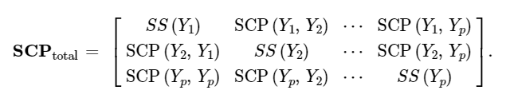
In order to calculate the multivariate statistics just mentioned here comes Sum of Cross Products again (SCP)
Y₁
Y₂
Y_{p}
Y₁
Y₂
Y_{p}
This matrix contains sum of squares for a particular variable in the diagonal and

Slide 8
Here comes Sum of Cross Products again (SCP)
Y₁
Y₂
Y_{p}
Y₁
Y₂
Y_{p}
Sum of cross products in the off-diagonal cells

Slide 9
The Multivariate Test of Significance
Remember that in ANOVA the overall test statistic is calculated as SS_{between} / SS_{within} and an F distribution is used to test the overall relationship between independent and dependent variables
The multivariate overall test statistics (Hotelling’s Trace , Wilk’s Lambda, Pillai’s Trace, Roy’s Largest Root) use
SCP_{between} / (SCP_{between} + SCP_{error})
Notes:
*Often you will see T = H + E, where H stands for hypothesis sums of squares, and E error sums of squares. In that case we’d have HE⁻¹

Slide 10
The Multivariate Test of Significance
How do we calculate SCP_{between} / (SCP_{between} + SCP_{error}) ?
Remember that we are not dealing with a single dependent variable anymore but multiple dependent variables so they need to be expressed as a matrix, so let’s translate the above into matrix form
BW⁻¹
We take the between subjects SCP matrix and post multiply by the inverted SCP error matrix
SCP_{between}
SCP_{error or within}
Notes:
*Often you will see T = H + E, where H stands for hypothesis sums of squares, and E error sums of squares. In that case we’d have HE⁻¹

Slide 11
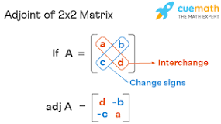
How do we invert the W (error) matrix?
Here is the error matrix W
W
Here is the determinant of W
|W|
Here is the inverse of W
W⁻¹
|W|
Note: If the matrix is bigger than 2 x 2 then
things get really messy…
Notes:
*If you’d like the easier way to do it, here is how to in R:
Wmatrix=matrix(c(88,80,80,126), ncol=2)
solve(Wmatrix)

Slide 12
Here are our SCP B and W matrices that we need from our psychology data!
← B matrix
← W matrix

Slide 13
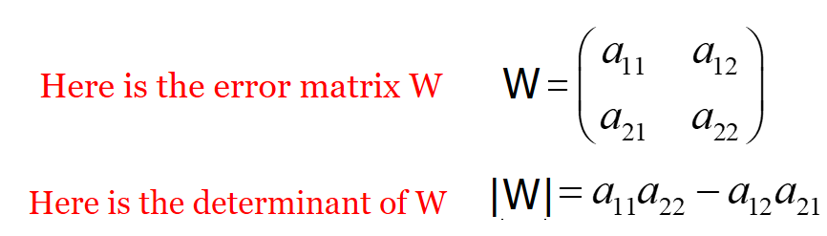
Let’s start with the determinant of the W matrix!
← B matrix
← W matrix
W = 88.00 80.00
80.00 126.00
|W| = (88*126) – (80*80) = 4688

Slide 14
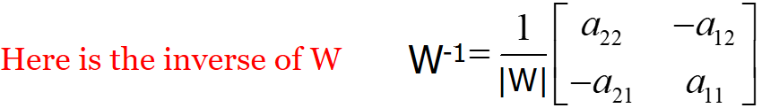
Let’s start with the determinant of the W matrix!
← B matrix
← W matrix
W⁻¹ = (1 / 4688) *
126.00 -80.00
-80.00 88.00
0.269 -.0171
-.0171 .0188
W⁻¹ =

Slide 15
Wow! That was a lot of work!
Now all we need to do is post multiply our SCPbetween (B matrix) by our inverted SCPwithin (W-1) matrix!
BW⁻¹
B
W⁻¹
Our Result!
Notes:
Here’s what I’ve done so far in R:
Bmatrix=matrix(c(210,-90,-90,90), ncol=2)
Wmatrix=matrix(c(88,80,80,126), ncol=2)
Tmatrix=Bmatrix+Wmatrix
Wmatinvers= solve(Wmatrix)
newmat=Bmatrix%*%Wmatinvers
eigen(newmat)

Slide 16
We’re almost there!
The last thing we need to do is extract the eigenvalues out of our result matrix. Why do we need to do that?
Look at the formula for Wilks lambda – one of our multivariate statistics below – you can see the lambda symbol λ that represents the eigenvalues for a matrix like the one we just calculated.
Remember that eigenvalues are a dimensional reduction technique that in our case represents magnitude of variance. You have seen them other places like Principle Components analysis.
Notes:
Here’s what I’ve done so far in R:
Bmatrix=matrix(c(210,-90,-90,90), ncol=2)
Wmatrix=matrix(c(88,80,80,126), ncol=2)
Tmatrix=Bmatrix+Wmatrix
Wmatinvers= solve(Wmatrix)
newmat=Bmatrix%*%Wmatinvers
eigen(newmat)

Slide 17
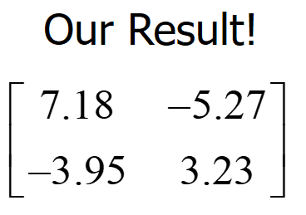

Calculate the eigenvalues from our result matrix
Here are the things we need to extract our eigenvalues from our result matrix
Jam the numbers in our result matrix into the following formula
Note: If the matrix is bigger than 2 x 2 then
things get really messy…
Notes:
Here’s what I’ve done so far in R:
Bmatrix=matrix(c(210,-90,-90,90), ncol=2)
Wmatrix=matrix(c(88,80,80,126), ncol=2)
Tmatrix=Bmatrix+Wmatrix
Wmatinvers= solve(Wmatrix)
newmat=Bmatrix%*%Wmatinvers
eigen(newmat)

Slide 18




Calculate the eigenvalues from our result matrix
Jam the numbers in our result matrix into the following formula
λ$± = ½ ∗[\left(7.18+3.23\right)±$ sqrt((4*-5.27*-3.95) + (7.18-3.23)^2)]
λ$± = ½ ∗[10.41±$ sqrt(83.266 + 15.6025)
λ$± = ½ ∗[10.41±$ sqrt(98.8685)
λ$± = ½ ∗[10.41±$ 9.9433]
λ$± = 10.1766 and .2334$
Notes:
Here’s what I’ve done so far in R:
Bmatrix=matrix(c(210,-90,-90,90), ncol=2)
Wmatrix=matrix(c(88,80,80,126), ncol=2)
Tmatrix=Bmatrix+Wmatrix
Wmatinvers= solve(Wmatrix)
newmat=Bmatrix%*%Wmatinvers
eigen(newmat)

Slide 19
Wilk’s Lambda
Here is the formula for Wilk’s Lambda
λ₁ = 10.1766
λ₂ = 0.2334
Wilks λ = [1/(1+10.1766)] * [1/(1+0.2334)]
Wilks λ = .0895 * .8108 = .0726
Yay!!!
Notes:
Here’s what I’ve done so far in R:
Bmatrix=matrix(c(210,-90,-90,90), ncol=2)
Wmatrix=matrix(c(88,80,80,126), ncol=2)
Tmatrix=Bmatrix+Wmatrix
Wmatinvers= solve(Wmatrix)
newmat=Bmatrix%*%Wmatinvers
eigen(newmat)

Slide 20
Pillai’s Trace
Here is the formula for Pillai’s Trace
λ₁ = 10.1766
λ₂ = 0.2334
Pilliai’s Trace = V = (10.1766/(1+10.1766)) + 0.2334/(1+0.2334))
Pilliai’s Trace = V = (.9105) + (.1892) = 1.0997
Yay!!!
Notes:
Here’s what I’ve done so far in R:
Bmatrix=matrix(c(210,-90,-90,90), ncol=2)
Wmatrix=matrix(c(88,80,80,126), ncol=2)
Tmatrix=Bmatrix+Wmatrix
Wmatinvers= solve(Wmatrix)
newmat=Bmatrix%*%Wmatinvers
eigen(newmat)

Slide 21
Hotelling’s Trace
Here is the formula for Hotelling’s Trace
λ₁ = 10.1766
λ₂ = 0.2334
Hotelling’s Trace = Ʃ λ_{i}
Hotelling’s Trace = Ʃ λ_{i} = 10.1766 + 0.2334 = 10.41
Yay!!!
Notes:
Here’s what I’ve done so far in R:
Bmatrix=matrix(c(210,-90,-90,90), ncol=2)
Wmatrix=matrix(c(88,80,80,126), ncol=2)
Tmatrix=Bmatrix+Wmatrix
Wmatinvers= solve(Wmatrix)
newmat=Bmatrix%*%Wmatinvers
eigen(newmat)

Slide 22
Roy’s Largest Root
Here is the formula for Roy’s Largest Root
λ₁ = 10.1766
λ₂ = 0.2334
Roy’s Largest Root = Max (λ)_{i}
Roy’s Largest Root= 10.1766
Yay!!!
Notes:
Here’s what I’ve done so far in R:
Bmatrix=matrix(c(210,-90,-90,90), ncol=2)
Wmatrix=matrix(c(88,80,80,126), ncol=2)
Tmatrix=Bmatrix+Wmatrix
Wmatinvers= solve(Wmatrix)
newmat=Bmatrix%*%Wmatinvers
eigen(newmat)

Slide 23
Different Multivariate test criteria
When there are only two levels for an effect that s = 1 and all of the tests will be identical
When there are more than two levels the tests should be close but may not all be similarly sig or not sig

Slide 24
Different Multivariate test criteria
As we saw, when there are more than two levels there are multiple ways in which the data can be combined to separate the groups
Wilk’s Lambda, Hotelling’s Trace and Pillai’s trace all pool the variance from all the dimensions to create the test statistic.
Roy’s largest root only uses the variance from the dimension that separates the groups most (the largest “root” or difference).

Slide 25
Which do you choose?
Wilks’ lambda is the traditional choice, and most widely used
Wilks’, Hotelling’s, and Pillai’s have shown to be robust (type I sense) to problems with assumptions (e.g. violation of homogeneity of covariances), Pillai’s more so, but it is also the most conservative usually.
Roy’s is the more liberal test usually (though none are always most powerful), but it loses its strength when the differences lie along more than one dimension
Some packages will even not provide statistics associated with it
However in practice differences are often seen mostly along one dimension, and Roy’s is usually more powerful in that case (if HoCov assumption is met)

Slide 26
Guidelines
Generally Wilks
The others:
Roy’s Greatest Characteristic Root:
Uses only largest eigenvalue (of 1st linear combination)
Perhaps best with strongly correlated DVs
Hotelling-Lawley Trace
Perhaps best with not so correlated DVs
Pillai’s Trace:
Most robust to violations of assumption

Slide 27
Post-hoc analysis
Many run and report multiple univariate F-tests (one per DV) in order to see on which DVs there are group differences; this essentially assumes uncorrelated DVs.
Furthemore if the DVs are correlated (as would be the reason for doing a Manova) then individual F-tests do not pick up on this, hence their utility of considering the set of DVs as a whole is problematic
So beware of multiple univariate tests

Slide 28
Multiple pairwise contrasts
In a one-way setting one might instead consider performing the pairwise multivariate contrasts, i.e. 2 group MANOVAs
Hotelling’s T²
Doing so allows for the detail of individual comparisons that we usually want
However type I error is a concern with multiple comparisons, so some correction would still be needed
E.g. Bonferroni, False Discovery Rate

Slide 29
Assessing significance
Remember that MANOVA may find significant differences with multiple dependent variables where individual univariate dependent tests may not be significant (just like discriminant analysis)
It is also possible sometimes that adding dependent variables that are not relevant can lead to non-significant overall test results even when other dependent variables are significant. Adding “garbage dependent variables” to the analysis can end in this result.

Slide 30
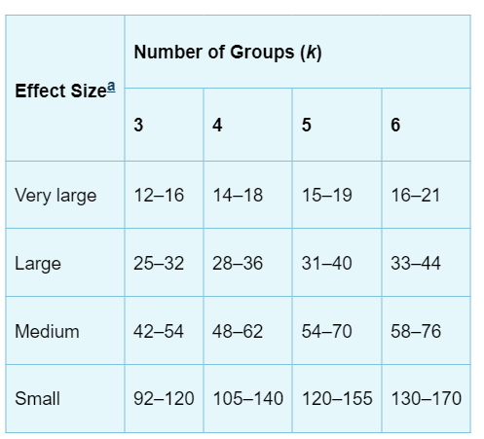
Sufficient Sample Sizes
Here is an idea of sample sizes for power=.7, α=.05 and number of groups k=3 to 6 and number of dependent variables p=3 to 6.
Adapted from Stevens (2009)
Notes:
*Here is how to think of DFA. First, as we have said MANOVA is a special case of cancorr in which one of the sets of variables contains dummy-coded variables representing group membership. Now, would the actual cancorr, which we identified as largely a descriptive procedure, ‘care’ which side had the coded variables in calculating the correlation? It would not. As such MANOVA and DFA are mathematically equivalent.

Slide 31
Box’s M test for homogeneity
Box’s M test that MANOVA typically uses for homogeneity in the SCP matrices is sensitive to sample size. In addition, violations of this assumption can be more serious in smaller sample sizes.
So for small sample sizes it is often advisable to set the α level higher – say .10 to .20 – to avoid issues
For large sample sizes, it is often advisable to set the α level lower – say .01 or .001 – to avoid triggering alarm when issues with variance homogeneity are typically small
Adapted from Stevens (2009)
Notes:
*Here is how to think of DFA. First, as we have said MANOVA is a special case of cancorr in which one of the sets of variables contains dummy-coded variables representing group membership. Now, would the actual cancorr, which we identified as largely a descriptive procedure, ‘care’ which side had the coded variables in calculating the correlation? It would not. As such MANOVA and DFA are mathematically equivalent.

